Slide 1
UNIFIED EXPERIENCE PLATFORM (UXP)
October 2023

Slide 2
AGENDA
Our Goals
Technology Approach
Cost
Benefits & Features
Technology Recommendation
Timelines
POC & Wireframes

Slide 3
OUR GOALS / WHY UXP?

Slide 4
OUR GOALS / WHY UXP?
VISION
BUSINESS STRATEGY
STEPS
WHAT
WHY
HOW
Momentum will implement a unified data solution that integrates data from disparate sources into a single view, providing accurate answers to critical questions.
A standardized and repeatable process is required for scheduling and recording activation data.
Create an application that will be to source of the truth for all activations within momentum.
Create a database that creates and stores all GUIDS and UIDs for both Campaigns and Events.
UXP technology will:
Streamline data collection.
Provide a centralized location.
Create a standard method when joining to 3rd Party
Data process discovery
Developing an application that can gather and unify data, allowing users to edit all data
Bi-directional API: Send & and receive event Information to any required system to create an event and receive back IDs so that bidirectional updates can be performed from either system.
Data governance: create a method to ensure data quality and completeness.
Training: All teams on how to enter events into the new application
PRODUCT
AIM
EXECUTE

Slide 5

USER PERSONA
PERSONA:
GOALS:
Name of Persona: Business Leaders & Project Managers Role: Familiar with account teams and account event scheduling, communicates with Clients' to understand number of events, event details, scope and timing for execution
A process to keep all campaigns & events up to date.
One source of truth for all event scheduling
Mitigate multiple spreadsheets and Smartsheets where events are tracked
Review upcoming and past events for planning
DESCRIPTION:
CHALLENGES:
My job is to oversee and drive the successful execution and delivery of projects within the agency, through building and orchestrating project plans across the business.
As a Business Leader or Project manager, I would like to have one location to track events for my client campaigns.
View upcoming, past, and scheduled events in a list and a calendar. I sometimes am required to provide Client with lists of events per region or team
All of my events require a unique QR code, I would like to tie each event with a QR code in an easier way to control and test.
Any event that requires BA recaps should talk to our field marketing platform to capture event metrics
Once executed, all final data should be sent to MOMO Bi
Siloed communication: change requests between client and production teams
Large volumes & multiple locations to track the same information
Multiple stakeholders in projects
WORKFLOW & FEATURES USED:
Scheduling event data: Event Name, Date, Location, Team
Assigning events to Field Marketing system
QR Code generation within UXP
Calendar and Event list within UXP

Slide 6
BENEFITS
Our primary audience is business leaders and project managers who are in charge of activations.
​DELIVERABLE | ​BENEFIT ​ | PAIN SOLVED ​
​Front End | ​Centralized management of all activation data ​ | Scattered and disorganized data across multiple systems ​
Database | ​All GUIDs, and base Information. Can be enriched with additional IDs and transactional data from 3rd party systems | ​Difficulty in tracking and managing events ​and multiple systems Manual GUID creation
APIs | Will connect bi-directional API's with third party systems | Manual downloads of data and manual data mapping
Training & Documentation | Streamline training and documentation across business units | Lack of unified training across teams and offices

Slide 7
TECHNOLOGY APPROACH

Slide 8
WHY WE ARE HERE?
We've evaluated two distinct approaches for our project.
We have a business decision, to determine the path forward for this project.
React Web Application
Conceptualization: We've developed the strategy.
Design: Outlined the architectural blueprints and created detailed wireframes.
Power Platform Application
Conceptualization: We've developed the strategy Design: Outlined comprehensive architectural plans and workflow design.
Action: Transformed this into a working proof of concept.

Slide 9











UNIFIED SYSTEMS VISION
ACTIVATIONS
TRACE
FIELD MANAGEMENT
LOCATION & EVENT INTELLIGENCE
rTAG
PROJECT
SCOPES
TIME
FEES
RESOURCES
CONTENT
GENERATIVE AI
DAM
APPROVALS
COGNITIVE SERVICES (AI/ML)

Slide 10

TODAY
Momentum gathers meaningful post-event metrics by unifying data from different sources.
Information is either not available or not shared in a timely manner.
This limits Momentums spend and agility when generating insights.

Slide 11
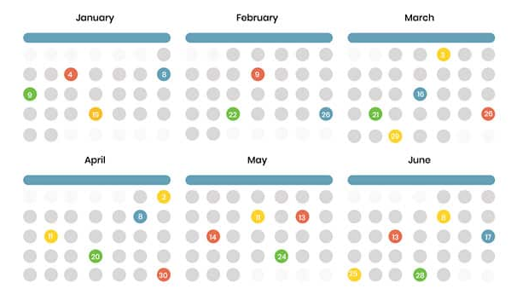





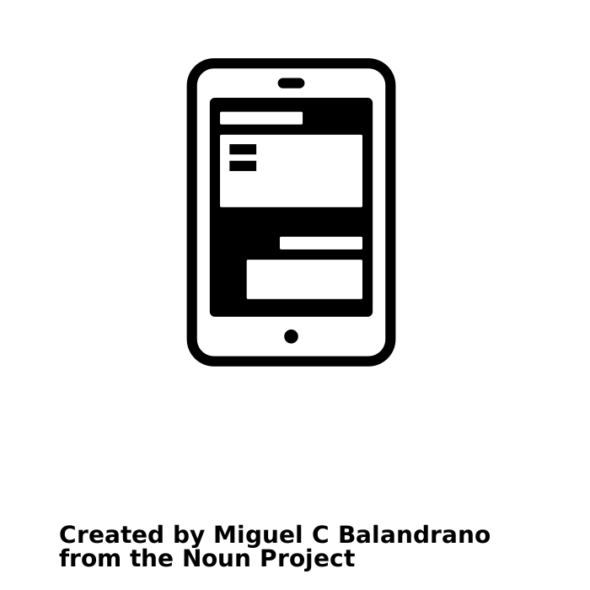



UNIFIED EXPERIENCE DATA ECOSYSTEM
Unified data aggregates data from disparate sources into a single view providing complete and accurate answers to critical questions.
Activation Schedule
Unified Experience Platform (UXP) and Input Procedure A front-end Input application and organization-wide process/system for collecting Activation Details and information: Activation Name, Activation Date, Activation Client, and Activation Location.
Unified Experience Data
Activation Insights
Field Management Portfolio-wide standardized system for managing event details, assets, and on-site wrap information. It includes a cloud/web-based tool accessible from anywhere for real-time updates and version control, eliminating the need for multiple spreadsheets.
Conversational Insights
Other systems: Walmart Hub, Splash, Placer data, Client owned systems
Cognitive Services

Slide 12




UXP COMPONENTS AND FLOW
USER INTERFACE
DATA
CAMPAIGN
New entry
DATABASE
EVENT
EVENT
Update data
Other system data
Other system data
Log data
EVENT
EVENT
CAMPAIGN ID
EVENT ID
EVENT ID
Other system data
Other system data
Display data
CAMPAIGN DATA
EVENT DATA
EVENT DATA
SYS DATA
Some apps will have a connection to Create entries
And send data back
Update data
OTHER SYSTEMS ENRICHMENT & COLLECTION
AUTOMATION
Interrogate data
SURVEYS
QR CODES
SCHEDULE
FIELD MANAGEMENT
LOCATION
Receive information
OTHER
OTHER

Slide 13


UXP COMPONENTS AND FLOW
USER INTERFACE
DATA
AI & INSIGHT
CAMPAIGN
DATABASE
EVENT
EVENT
Other system data
Other system data
EVENT
EVENT
CAMPAIGN ID
EVENT ID
EVENT ID
Other system data
Other system data
CAMPAIGN DATA
EVENT DATA
EVENT DATA
SYS DATA
OTHER SYSTEMS ENRICHMENT & COLLECTION
AUTOMATION
SURVEYS
QR CODES
SCHEDULE
FIELD MANAGEMENT
LOCATION
OTHER
OTHER

Slide 14








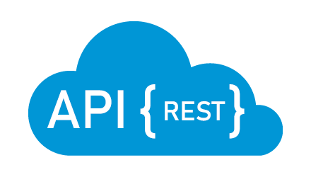
UXP APPROACH
OPTION 1 - - REACT WEB APPLICATION
OPTION 2 - - POWER PLATFORM
3rd party development
Momentum development
USER INTERFACE
DATA
AUTOMATION
USER INTERFACE
DATA
AUTOMATION
LOG4NET
DATAVERSE
POWER APPS
(on demand)
POWER AUTOMATE
(Scheduled)
REACT
AZURE SQL
RESTSHARP
POWER APPS
NHIBERNATE
or SQL
or EXISTING ATA TEAM SETUP

Slide 15
UXP: PROS
OPTION 1 - - REACT WEB APPLICATION
OPTION 2 - - POWER PLATFORM
3rd party development
Momentum development
USER INTERFACE
DATA
AUTOMATION
USER INTERFACE
DATA
AUTOMATION
LOG4NET
DATAVERSE
POWER APPS
(on demand)
POWER AUTOMATE
(Scheduled)
REACT
AZURE SQL
RESTSHARP
POWER APPS
NHIBERNATE
or SQL
or EXISTING DATA TEAM SETUP
PROS
PROS
Technology agnostic
Can handle more complex logic
Cross-platform compatibility
Open-source tools
No year-one development hard cost
Additional features at no extra cost
Microsoft ecosystem
Data integration
Scalability
Free map data
Framework is reusable
Automation QR data refresh

Slide 16
UXP: CONS
OPTION 1 - - REACT WEB APPLICATION
OPTION 2 - - POWER PLATFORM
3rd party development
Momentum development
USER INTERFACE
DATA
AUTOMATION
USER INTERFACE
DATA
AUTOMATION
LOG4NET
DATAVERSE
POWER APPS
(on demand)
POWER AUTOMATE
(Scheduled)
REACT
AZURE SQL
RESTSHARP
POWER APPS
NHIBERNATE
or SQL
or EXISTING ATA TEAM SETUP
CONS
CONS
Year one development hard cost
Support hard cost
Costly additional features
3rd-party dependency
Ensuring compatibility with browsers, devices & libraries
Limited to Power Platform
Can’t handle overly complex logic
PowerApps might not offer the same level of performance as a custom-built web app

Slide 17
UXP: COSTS
OPTION 1 - - WEB APPLICATION
OPTION 2 - - POWER APP
COSTS
3rd Party Development
Momentum Development
Hard Costs (Development)
Soft Costs (Luis, Kristen, Nick, Reed, Yeuting, Steve)
Monthly User Cost
Running costs month (servers, db, etc.)
Scheduled automations
Additional features
Support & training – Hard Costs
Support & training – Soft Costs
Maintenance (library updates, dev work, etc.)
$120,000
$15,000
$-
$150
$-
Additional hard cost
$50,000 (estimated)
$30,000 (estimated)
$55,000 (estimated)
$-
$80,000
$5 (100 users = $500 a month)
$-
$- (can use existing license)
Additional soft cost
$- (soft cost estimated)
$50,000 (estimated)
$-

Slide 18
TOTALS
UNLIMITED USERS
200 USERS
 | REACT WEB APPLICATION
 | Hard Costs | Soft Costs
Year One: Dev Cost | $ 120,000 | $ 15,000
Year One: Support/Maintenance | $ 105,150 | $ 30,000
TOTAL YEAR ONE | $ 270,150
Year One: User Cost | $- | $-
TOTAL YEAR ONE | $ 270,150
Year 2 | $135,150
 | POWER PLATFORM
 | Hard Costs | Soft Costs
Year One: Dev Cost | $- | $ 80,000
Year One: Support/Maintenance | $- | $ 50,000
TOTAL YEAR ONE | $ 130,000
Year One: User Cost | $ 12,000
TOTAL YEAR ONE | $ 142,000
Year 2 | $62,000
Additional Users | Additional Hard Costs | Year Two Total
+50 | $3,000 | $65,000
+100 | $6,000 | $68,000
+150 | $9,000 | $71,000

Slide 19
THE TACTICAL PLAN: “DATA SCIENCE” TO “DATA ENGINEERING”
Eliminate the Data Science team to achieve direct cost savings.
Shift to existing data engineering targeted to drive efficiency and automation.
Integrated Production team leads client engagement to maintain continuity and integrate data into the existing technology lead thinking.
Leverage 1Rivet for execution, reducing internal costs.
INTEGRATED PRODUCTION
ASKS THE RIGHT QUESTIONS​
DETERMINES DATA STORY DELIVERABLES​
IMPROVES THE QUALITY OF THE WORK​
RESEARCH
Lisa Gramling
DATA STRATEGY
SAAS SERVICES, DATA LAKES, INTEGRATIONS, SCALED SOLUTIONS ARCHITECTURE, HYGIENE, PRIVACY, SECURITY, CLOUD/ COGNITIVE SERVICES, CISO COMPLIANCE, ETC.
New Leadership Structure:
Integrated Production: Melissa Hamilton & Team: Engagement with clients, requirements, managing stakeholders.
Data Strategy: Steve Sanderson + Team: Lead Data Engineering execution.
Existing Partnership: Kristen and Lisa continue working closely to create required documented use cases for Data Services.
External Execution Partner 1Rivet: External execution partner, absorbing production work at a lower cost.
EXECUTION
DATA VISUALIZATION
DATA INSIGHTS, DATA VISUALIZATION & BACKEND DEVELOPERS RETAINED HOURS FOR IDENTIFIED ROLES
DATA ANALYSTS
SQL ENGINEERS BLENDED PRICING
~$45 - $75 PER HOUR​
DATA ENGINEERING

Slide 20
KEY FEATURES
FEATURE | BENEFIT | PAIN SOLVED
Unified Experience Tracker (UXP) | Centralized management of activation data | Scattered and disorganized data across multiple systems
Master Program ID & Event ID | Unique identifiers for each campaign and event | Difficulty in tracking and managing events
API Integration | Seamless communication with field management systems | Manual data transfer and synchronization
Unified Database | Consolidated data storage | Redundancy and inconsistency in data storage
Calendar View | Easy visualization of scheduled events | Inefficient event planning and tracking
Client Power BI Dashboards | Customizable data visualization for clients | Limited client access to data and insights
Synchronization Between Systems | Real-time data updates across UXP and field management systems | Inconsistent data between systems
Permissions & Access Control | Per client team | Partitioning clients depending on accounts
Input And Update Data In Both Systems | Flexibility in managing activation and event wrap data | Inflexible data management process

Slide 21
TECHNOLOGY RECOMMENDATION
We recommend building the UXP using the POWER PLATFORM.
The decision aligns with our technology stack and objectives and the overall integration of IPG and momentum within Microsoft technologies.
Factors that influenced the decision:
Cost savings.
Rapid deployment potential. Developed the functional POC within two weeks.
Streamlined maintenance: operational savings.
Scalability and room for future growth: Accommodate future enhancements and new features without undergoing major redevelopment efforts.
Microsoft 365 integration. Effortless connection to other Microsoft services.
Leveraging pre-built connectors. Azure data, Bing maps, etc.
We anticipate a 47% saving vs. building a React web application on year 1 and 54% on consecutive years.
Manual steps to download client data need to be addressed separately. Greater efficiency could be determined.

Slide 22
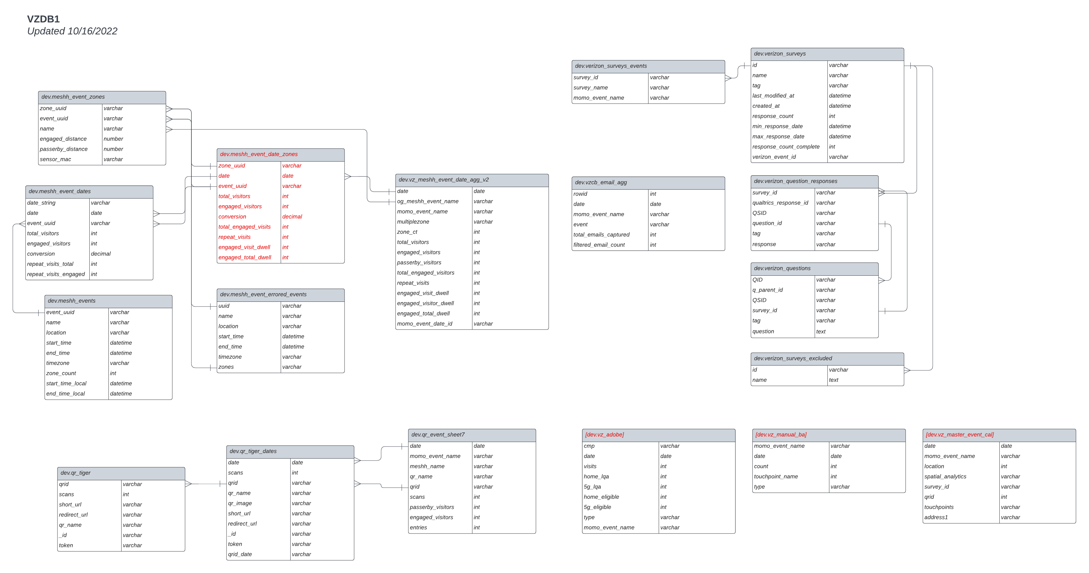
NEXT STEPS
Agree Technology
Document Business Process
Complete Framework UI
QR Code Technology Review
Current Data Architecture To be updated
Qualtrics API Current state documentation
Create SQL /Dataverse Tables
Pressure Test Application
Plan Lunch

Slide 23
TIMELINE

Slide 24
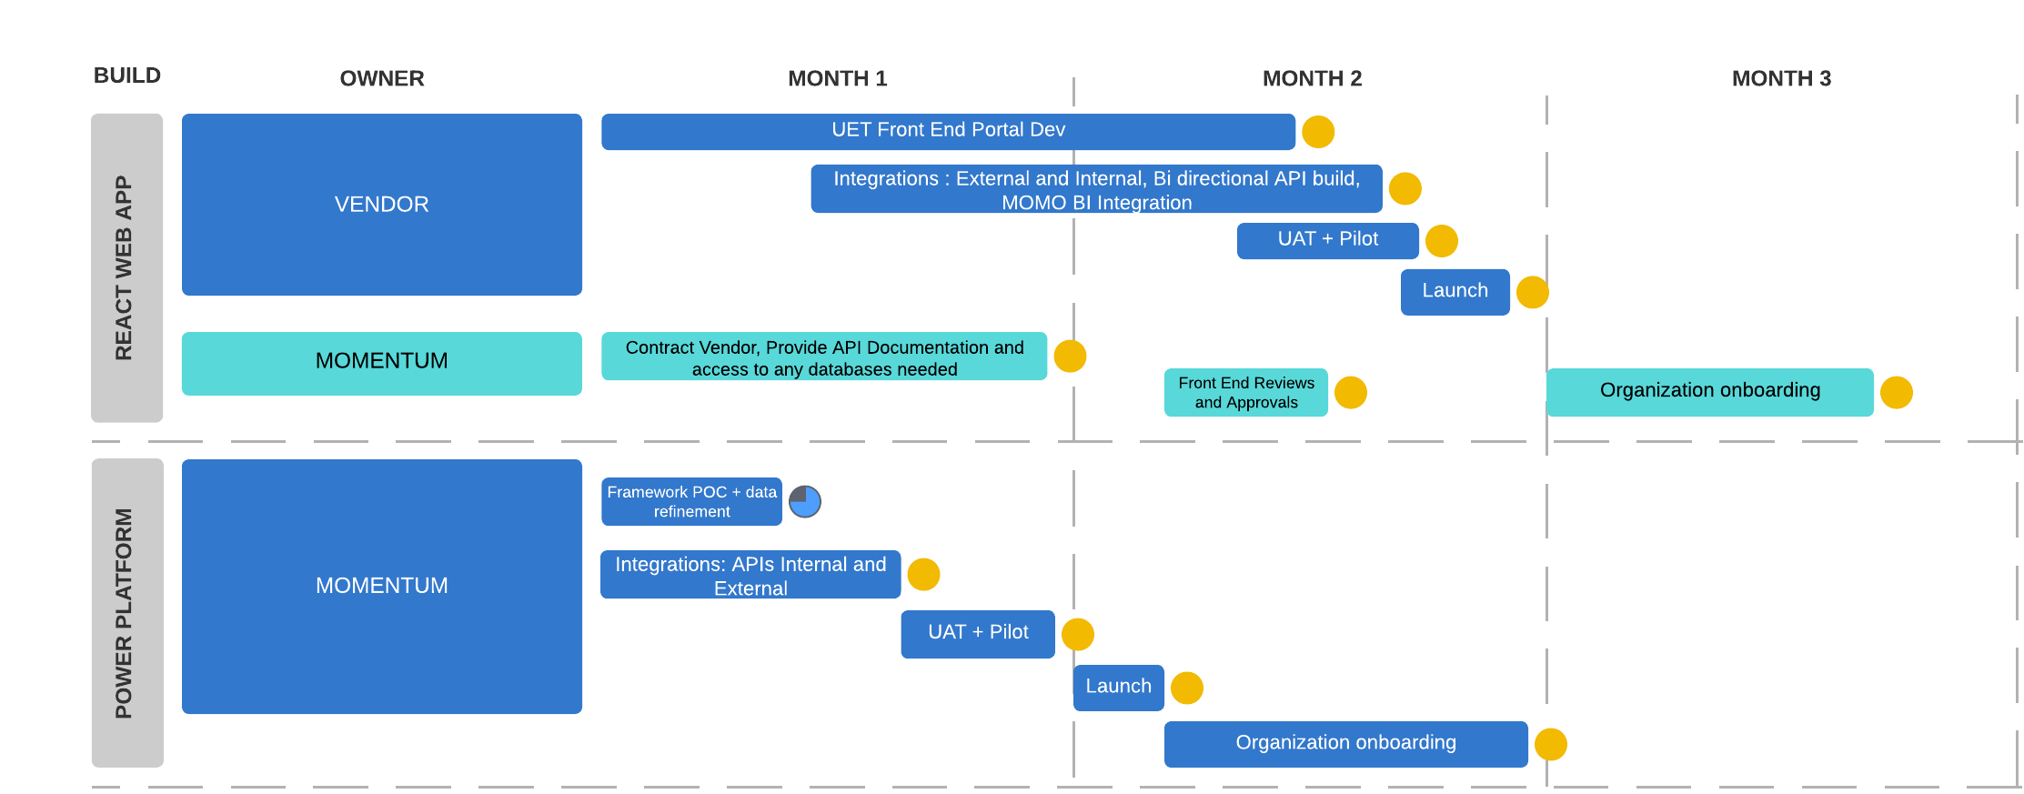
TIMELINE

Slide 25
TECHNOLOGY RECOMMENDATION
After conducting a successful Proof of Concept (POC) with PowerApps Technology team recommend this option.
In conclusion, based on the successful POC, anticipated cost savings, rapid deployment potential, and room for future growth.
Momentum’s global technology recommends embracing PowerApps for the Unified Experience Tracker project. This decision not only aligns with our technology stack and objectives but also positions us to achieve operational excellence and drive innovation within Momentum. The POC demonstrated the technical feasibility but also the potential of PowerApps.
We created a functional prototype
Leveraging pre-built connectors
Microsoft 365 integration
Developed within two weeks.
Savings:
We anticipate a x% saving vs. building a React web application.
Streamlined maintenance offered by PowerApps translates into ongoing operational savings.
PowerApps opens the door to possibilities for expanding the UXP's features and functionalities. Its scalability means we can readily accommodate future enhancements and requirements without undergoing major redevelopment efforts.
This flexibility empowers us to evolve the UXP in response to changing business needs and market dynamics, ensuring it remains a valuable asset for our Momentum.
In conclusion, based on the successful POC, anticipated cost savings, rapid deployment potential, and room for future growth, Momentum’s global technology recommends embracing PowerApps for the Unified Experience Tracker project. This decision not only aligns with our technology stack and objectives but also positions us to achieve operational excellence and drive innovation within Momentum.

Slide 26
POWER PLATFORM PROOF OF CONCEPT

Slide 27
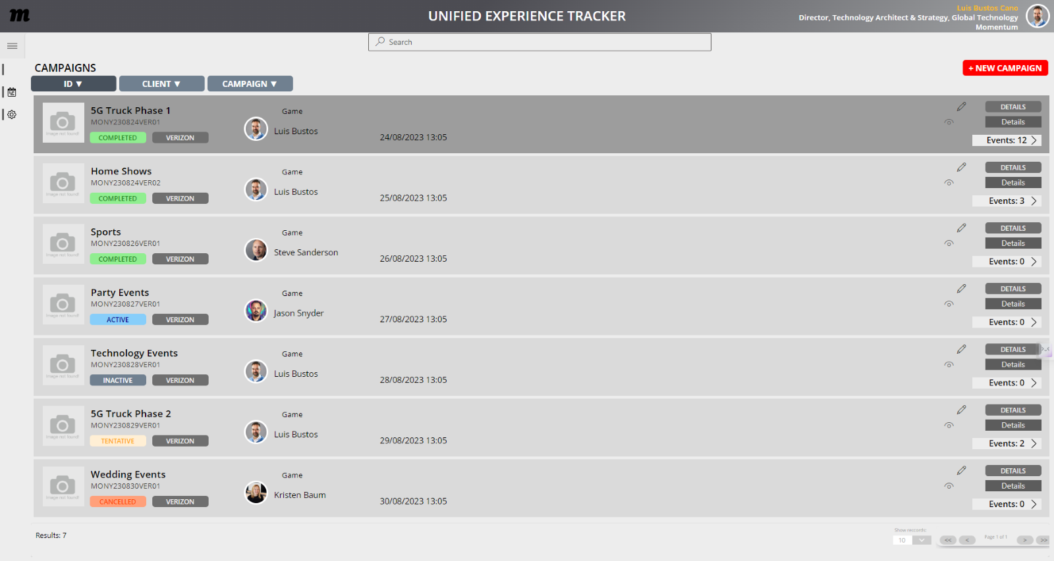
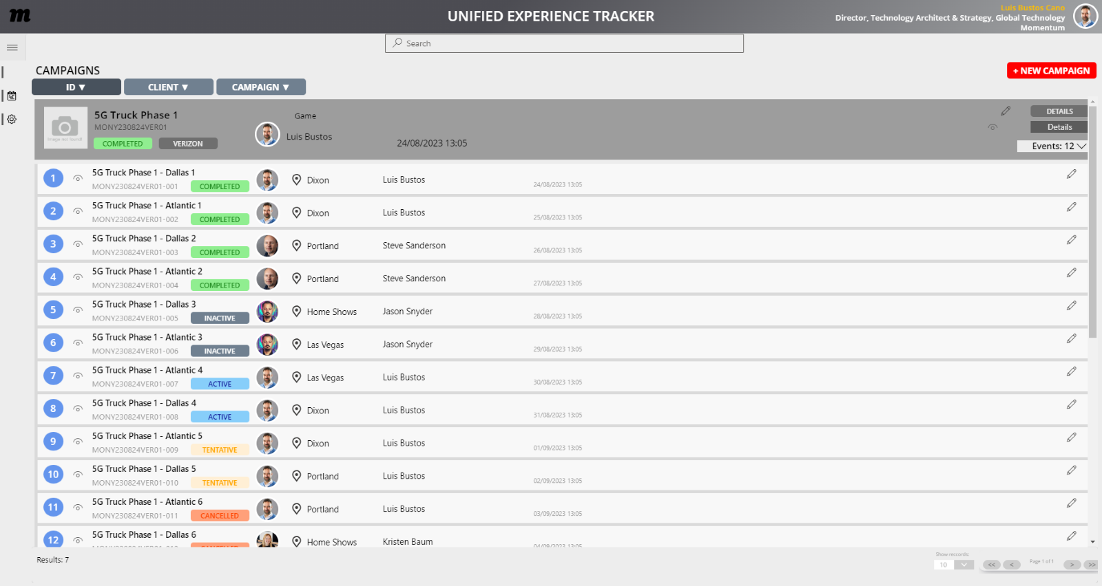
CAMPAIGNS & EVENTS
Create, edit, delete Events
Display Event data
Create an intelligible campaign ID
Sorting search returns based on criteria: ID, Name, Status, etc
Pagination
Retrieve AD data for event originator/assignee
Display map data and standardized address

Slide 28
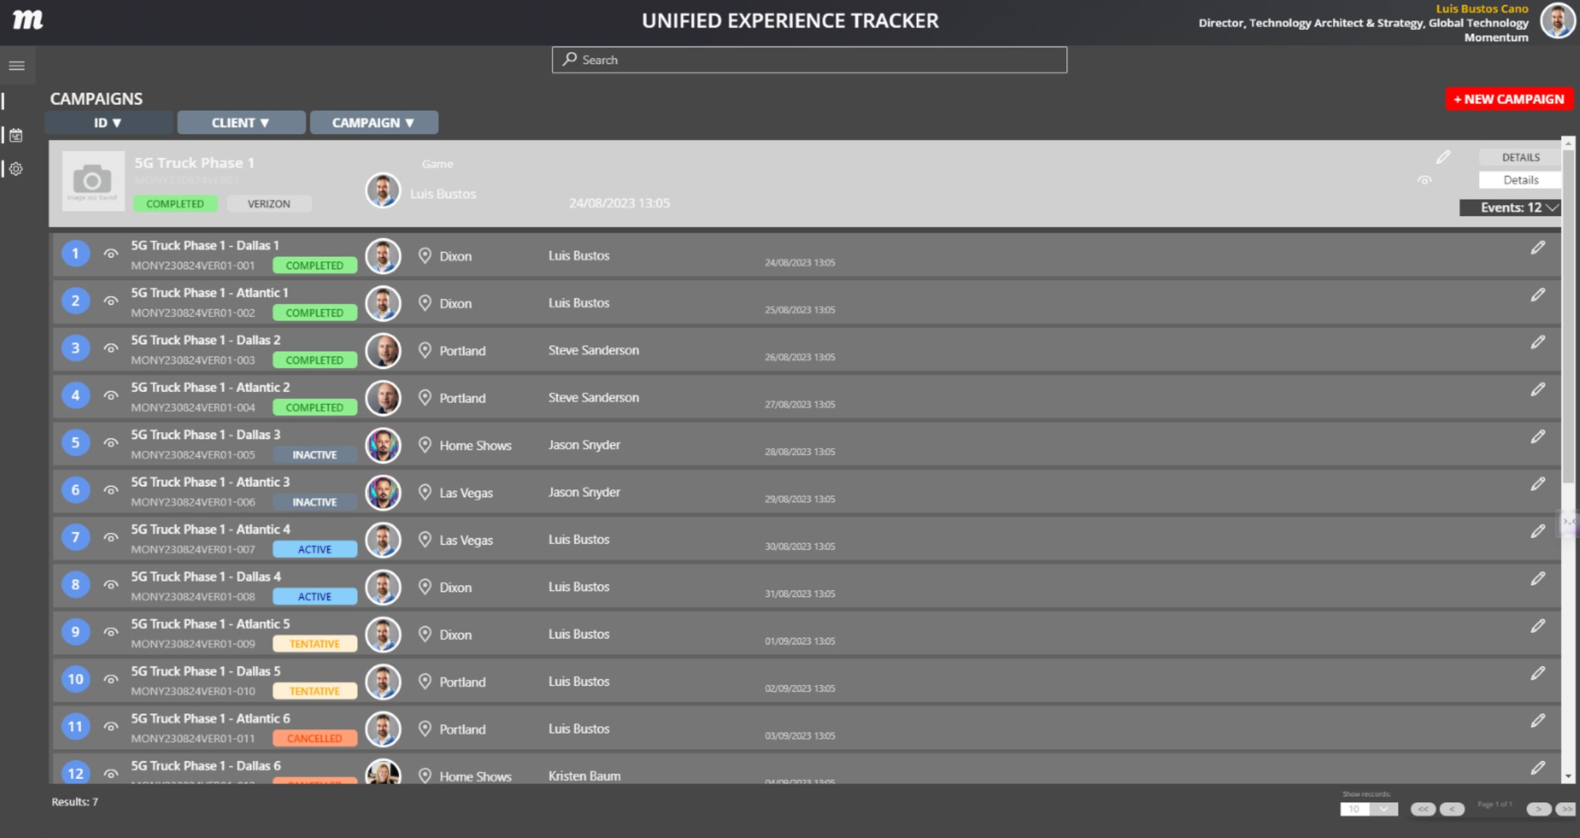
CAMPAIGNS & EVENTS
TURES
Theme variations stored at user-level permissions
This can include read/write permissions or view only permissions
Configurable by:
Client
User
Team

Slide 29
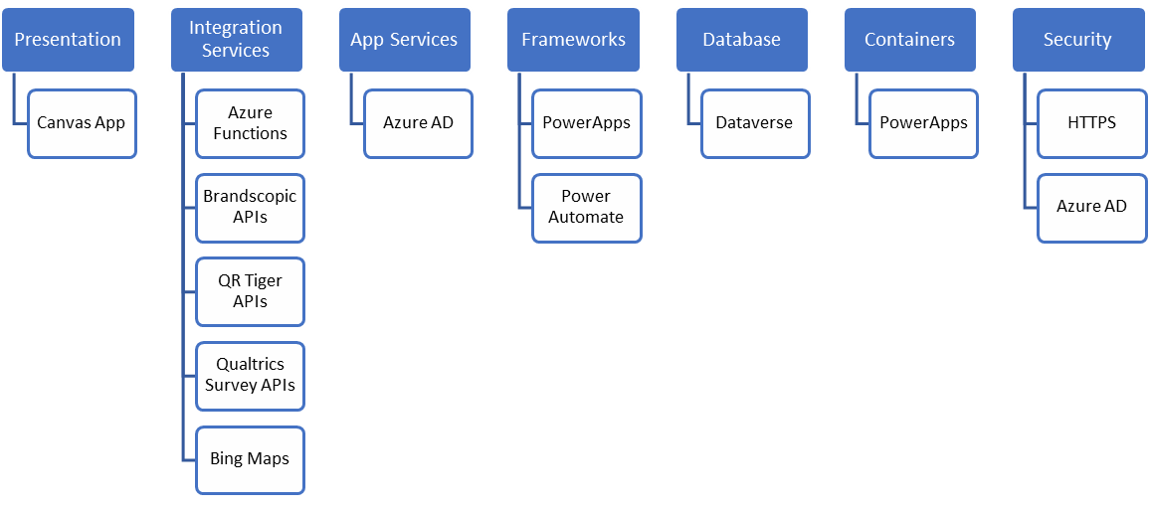
POWER PLATFORM SERVICES
Primary Platform: MS Power Platform - Power Apps, Power Automate, Dataverse, Azure
Development Team: Momentum

Slide 30
FUNCTIONALITY
Demonstrate user journey using PowerApps
Analyze UI capabilities
Check the ability to generate, store and retrieve even data with PowerApps
Check ability to interact with Dataverse
Verify custom Integrations
Creation, editing and retrieval of QRtiger data

Slide 31
WEB APPLCATION WIREFRAMES

Slide 32
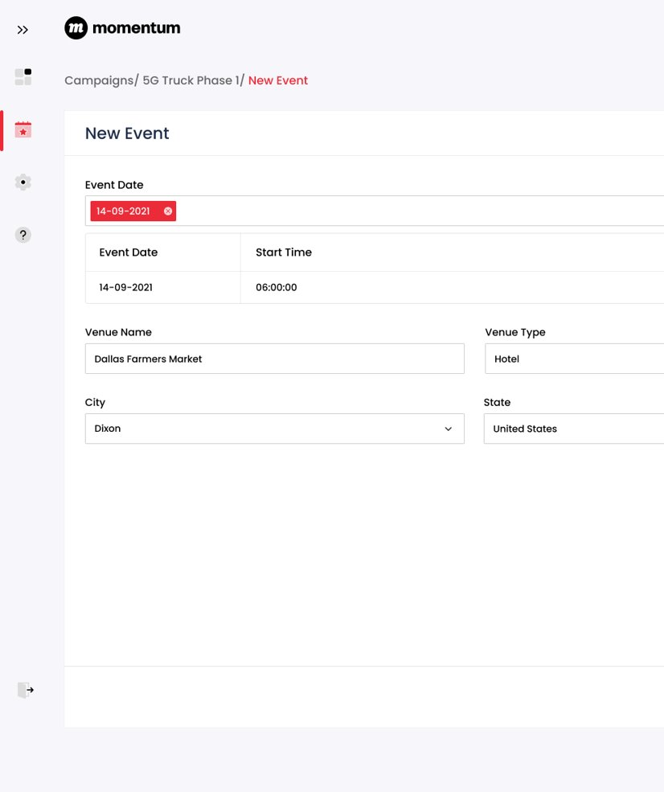
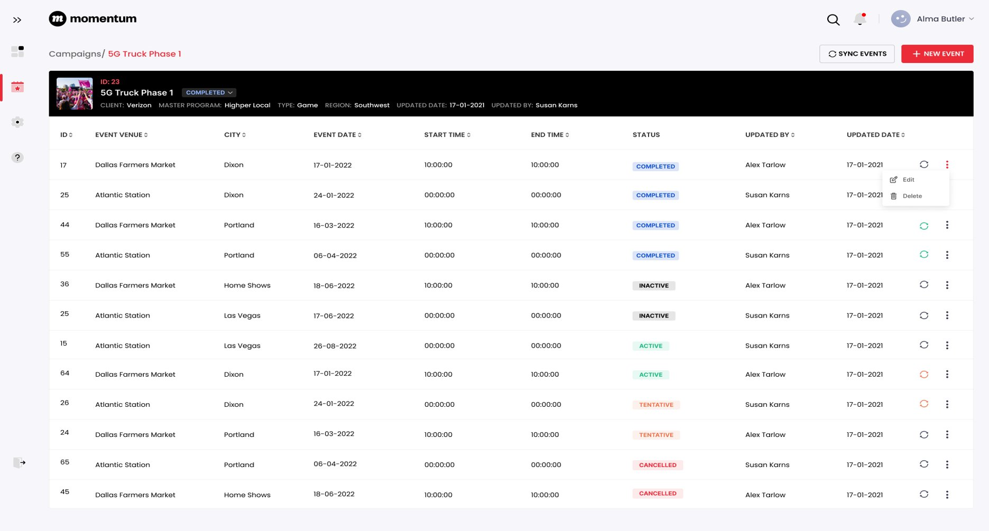
CAMPAIGNS & EVENTS

Slide 33
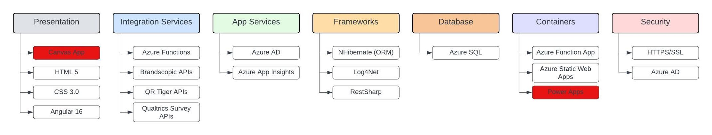
REACT APP SERVICES

Slide 34
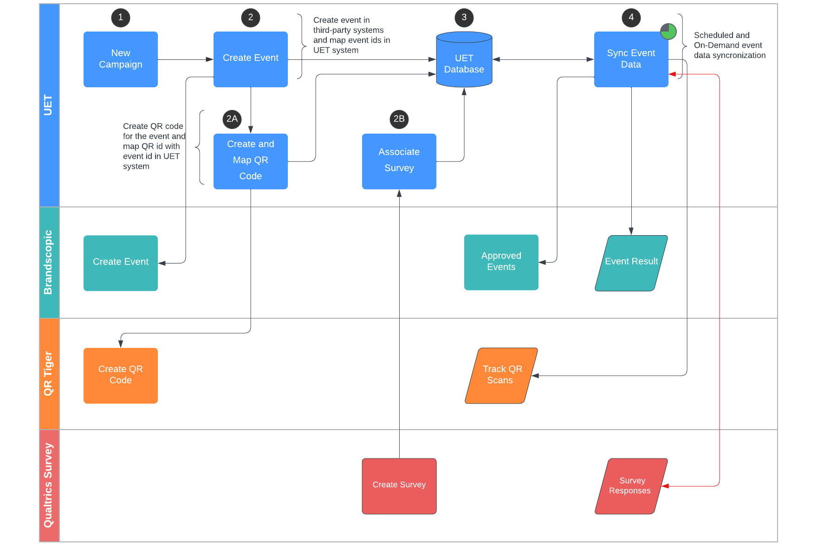
Web App Process Flow

Slide 35
PRODUCT EVOLUTION

Slide 36
LOOKING AHEAD: Beyond Unified Data Model
PHASE 1 Unified Event Data | PHASE 2 Product | PHASE 3 Commercial Pricing
Continued ingestion of both our current client and MOMO proprietary event data Standardized ingestion models API, 3rd party data sources, tagging/flagging Storage Cognitive Services / queries | Ingest new client data – use of standard method as well as data transformation required Compare client data to our event data by category – outside/inside, sports, music etc. , timing, weather Generate reports – trends, benchmark comparisons, “We Know” series etc. Dashboards of client data with some benchmarks/comparison flags by category | Ingestion Pricing – one time & ongoing, use of API Category inclusion Pricing for comparison (do some cost more?) Custom report Pricing for deeper dives into your data and the comparison to our data set Dashboard creation/access Pricing with licensing/seat access

Slide 37
DATA ECOSYSTEM

Slide 38




UNIFIED EXPERIENCE DATA ECOSYSTEM
Unified data aggregates data from disparate sources into a single view providing complete and accurate answers to critical questions.
Activation Schedule
Business Leadership
Unified Experience Data
Unified Experience Tracker (UXP)
Data Driven Insights
Activation Insights
Event Hub
Inc. Cross Client Benchmarking
Field Team
Conversational Insights
Training & Media
Staffing Agency Integration
Wrap Data
Data Driven Insights
Field Management
Other location & event intelligence
Cognitive Services

Slide 39
APPROACHES: PROS
OPTION 1: TECHNOLOGY: WEB APPLICATION | OPTION 2: POWER PLATFORMS
3RD PARTY VENDOR DEVELOPMENT | MOMENTUM DEVELOPMENT:
Full Control: It would provide complete control over the design, functionality, and performance, allowing the creation of highly customised solutions. Technology Agnostic: Allow to stack that best a project's needs, giving you flexibility in development. Complex Logic: Can handle complex logic in a more performant way. No license cost: No license is required Cross-Platform Compatibility: Web apps can run on various platforms and devices with internet access. Open Source Tools: Can leverage open-source tools and libraries to reduce development costs and speed up development. Community Support: There's a vast community of developers and resources available for web app development, making it easier to find solutions to problems. | No upfront development Cost: Less investment (i.e. Internal hours ~$80,000 ) No support Cost: no need for ongoing maintenance, updates, and security patches. Additional features at no extra cost. Inhouse configuration allows for the implementation of additional features without outsourcing. i.e. integration with Kantata, AI brief, etc. Integration with Microsoft 365: Seamless integration with other Microsoft 365 services through pre-built connectors, ideal for Momentum where there is already an investment in the Microsoft ecosystem. Reuse of existing functionality: Allow for reusing functionality already used for other internal applications. Mobile-Friendly: PowerApps generates mobile-responsive apps by default, making it easy to create a responsive app that would adapt to on-the-move users. Data Integration: It offers easy integration with various data sources, including Dataverse, on-premises and cloud-based databases, making it suitable for data-driven applications. Security: It leverages Azure Active Directory for user authentication and provides robust security features, ensuring data and app protection. Scalability: Apps can be scaled to more complex solutions as needs grow. Free Map data: Can leverage functionality without additional licensing cost (BING addresses to standardise addresses) Migration: Allows for the migration of the process to a separate framework.

Slide 40
APPROACHES: CONS
OPTION 1: TECHNOLOGY: WEB APPLICATION | OPTION 2: POWER PLATFORMS
3RD PARTY VENDOR DEVELOPMENT | MOMENTUM DEVELOPMENT:
High Initial Development Cost: Initial development cost of $120,000. Support Cost: Additional support cost tied to this option, which has not been scoped on the estimate provided by the 3rd party. Costly additional features. Cost for any additional features and integrations derived of future requirements. Development Time: Development would be more time-consuming 3rd party dependency: A higher level of technical expertise requires a 3rd party to handle development and ongoing support. Maintenance: Requirement for ongoing maintenance, updates, and security patches. Compatibility Issues: Ensuring compatibility with various browsers and devices can be challenging. | Limited Customization: It doesn’t offer the same level of customization and flexibility as traditional development languages and tools, may not be necessary for corporate tools that don’t require animations and visual enhancements. Complex Logic: Handling complex business logic can be challenging in PowerApps, especially for intricate workflows. License cost: Licensing costs can add up when used by a large number of users (check table below) Performance: For extremely large or data-intensive applications, PowerApps might not offer the same level of performance as a custom-built web app.

Slide 41
POC - THEMES

Slide 42
THEMES
FEATURES
Theme variations stored at user level permissions This can include read/write permissions or view only permissions Configurable by: Client User Team

Slide 43
EVENTS
FEATURES
Create, edit, delete Events Display Event data Create an intelligible campaign ID Sorting search returns base on criteria (ID, Name, Status, etc) Pagination Retrieve AD data for event originator/assignee Display map data and standardised address

Slide 44
COST COMPARISONS
COSTS | OUTSIDE VENDOR | INTERNAL MOMENTUM DEV
Hard Costs (Development ) | $120,000 | $-
Internal Hours | $15,000 | $80,000
Monthly user cost | $- | $5 (100 users. $500 a month)
Running costs month (servers, db, etc.) | $113.56 | $-
Scheduled automations | $- | $- (can use existing license)
Additional features | Additional cost based on scope | $-
Support | Additional cost based on scope | $- will vary depending on requests

Slide 45
POC - EVENTS

Slide 46
USER INTERFACE
DATA
CAMPAIGN
New entry
DATABASE
EVENT
EVENT
Update data
Other system data
Other system data
Log data
EVENT
EVENT
Other system data
Other system data
Display data
CAMPAIGN
EVENT
EVENT
SYS DATA
Create entry
Send data back
Update data
OTHER SYSTEMS
AUTOMATION
Interrogate data
SURVEYS
QR CODES
SCHEDULE
FIELD MANAGEMENT
LOCATION
Receive information
OTHER
OTHER

Slide 47



UXP COMPONENTS AND FLOW
OPTION 1
OPTION 2
USER INTERFACE
DATA
USER INTERFACE
DATA
AUTOMATION
AUTOMATION

Slide 48
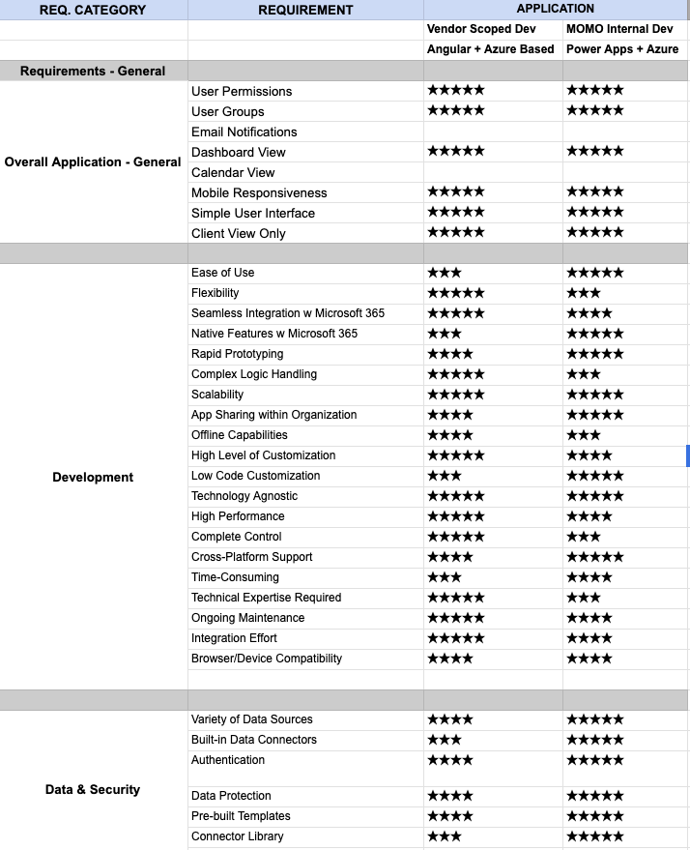
FEATURES COMPARISON

Slide 49
APPROACHES: PROS
OPTION 1: TECHNOLOGY: WEB APPLICATION | OPTION 2: POWER PLATFORMS
3RD PARTY VENDOR DEVELOPMENT | MOMENTUM DEVELOPMENT
Technology Agnostic Complex Logic No license cost Cross-Platform Compatibility Open Source Tools | No upfront development cost Additional features at no extra cost Integration with Microsoft 365 Data Integration Scalability Free Map data

Slide 50
APPROACHES: CONS
OPTION 1: TECHNOLOGY: WEB APPLICATION | OPTION 2: POWER PLATFORMS
3RD PARTY VENDOR DEVELOPMENT | MOMENTUM DEVELOPMENT
High Initial Development Cost Support Cost Costly additional features 3rd party dependency Compatibility Issues | Limited Customization Complex Logic Performance
Notes:
Limited Customization: It doesn’t offer the same level of customization and flexibility as traditional development languages and tools, may not be necessary for corporate tools that don’t require animations and visual enhancements.
Complex Logic: Handling complex business logic can be challenging in PowerApps, especially for intricate workflows.

